Slide 1


DIE FALLE DES FALSCHEN SICHERHEITSGEFÜHLS
DIE FALLE DES FALSCHEN SICHERHEITSGEFÜHLS
WIE SICH ENTWICKLER SICHER SICHER FÜHLEN
Notes:
Wer kennt das Gefühl von: “Läuft mein Code, oder was kann alles schiefgehen?”
bzw. zwecks Schlafen in der Nacht

Slide 2

Wenn du so vehement die Ursachenforschung unterbindest, musst du dich nicht wundern, dass sich das Problem nicht lösen lässt.
Wenn du so vehement die Ursachenforschung unterbindest, musst du dich nicht wundern, dass sich das Problem nicht lösen lässt.
– Marc-Uwe Kling // Die Känguru-Apokryphen
Notes:
Erfahrungsbericht
da Pharma-Branche und Quality-Startup versuchen wir einfach viele Prozesse zu hinterfragen (dev, mgmt)
nicht der Weisheit letzter Schluss, aber halt wie es uns ergangen ist
The Deeptraining Company (Begriff der Erkenntnis, falsches Sicherheitsgefühl -> richtiges Sicherheitsgefühl)

Slide 3

ASSURING QUALITY BY
PSYCHOLOGY

Slide 4








Slide 5






MINDSET
direct communication (tools)
as little as possible remote work
chatting @ work
“just ask” mentality
heterogenous team (co-working-space)
pull requests (reading code)
project planning
workation
Notes:
Mindset/Team-Building/Wissensaustausch/Entwicklungsprozess
weekly Meetings
as little as possible remote
communication
P49: chatting @ work
just ask
heterogenes Team
Pull Requests
Workation
Projektplanung/Zeitschätzung
Startup Initialphase
Frameworkentwicklung vs. Produktentwicklung (Zeitfaktor, aber solide Basis)
VR Entwicklung Interaktionsmuster vs. Agentur App-Entwicklung (95% easy abschätzbar)

Slide 6

EGOLESS PROGRAMMING
Understand and accept that you will make mistakes.
You are not your code.
No matter how much "karate" you know, someone else will always know more.
Don't rewrite code without consultation.
Treat people who know less than you with respect, deference, and patience.
The only constant in the world is change.
The only true authority stems from knowledge, not from position.
Fight for what you believe, but gracefully accept defeat.
Don't be "the guy in the room."
Critique code instead of people – be kind to the coder, not to the code.
[1]
Notes:
als ich mir überlegt habe wie wir eigentlich Entwickeln ist mir Egoless Programming untergekommen

Slide 7



showcase { jira }
showcase { confluence }
showcase { github }

Slide 8
DIE FALLE DES FALSCHEN SICHERHEITSGEFÜHLS

Slide 9
ASSURING QUALITY BY
TECHNOLOGY

Slide 10
👨‍🏭
And how long does your program take?
👨‍🎤
✈
🏭
💾
🚗
💺
👨‍🎤
That varies with the input, but on the average, about ten seconds per card.
📚
👥
🙅‍♀️
💥
🌙
👥
body color
body style
equipment
air condition
👨‍🏭
½ day on the plane
1 day finishing
2 days for specification
7 days testing
Aha, but my program takes only one second per card.
👨‍🎤
🔚
✈
😌
🚀
👷‍♂️
❌
🙅‍♀️
👨‍🎤
⌚
👨‍🎤
👨‍💼
TEAM FEELS RELIEVED
👨‍🎤
But your program doesn’t work. If the program doesn’t have to work, I can write one that takes one millisecond per card and that’s faster than our card reader.
📈
✈
🏭
🤝
🚅
✔
about correctness in computer systems

Slide 11
“Of all the requirements that we might place on a program, first and foremost is that it be correct.”
about correctness in computer systems

Slide 12

WE HAVE LIMITED SPACE FOR OUR WORKING MEMORY, AND USING IT UP FOR ANYTHING A COMPUTER CAN DO FOR US IS COUNTER-PRODUCTIVE.
WE HAVE LIMITED SPACE FOR OUR WORKING MEMORY, AND USING IT UP FOR ANYTHING A COMPUTER CAN DO FOR US IS COUNTER-PRODUCTIVE.
– Chris Allen

Slide 13
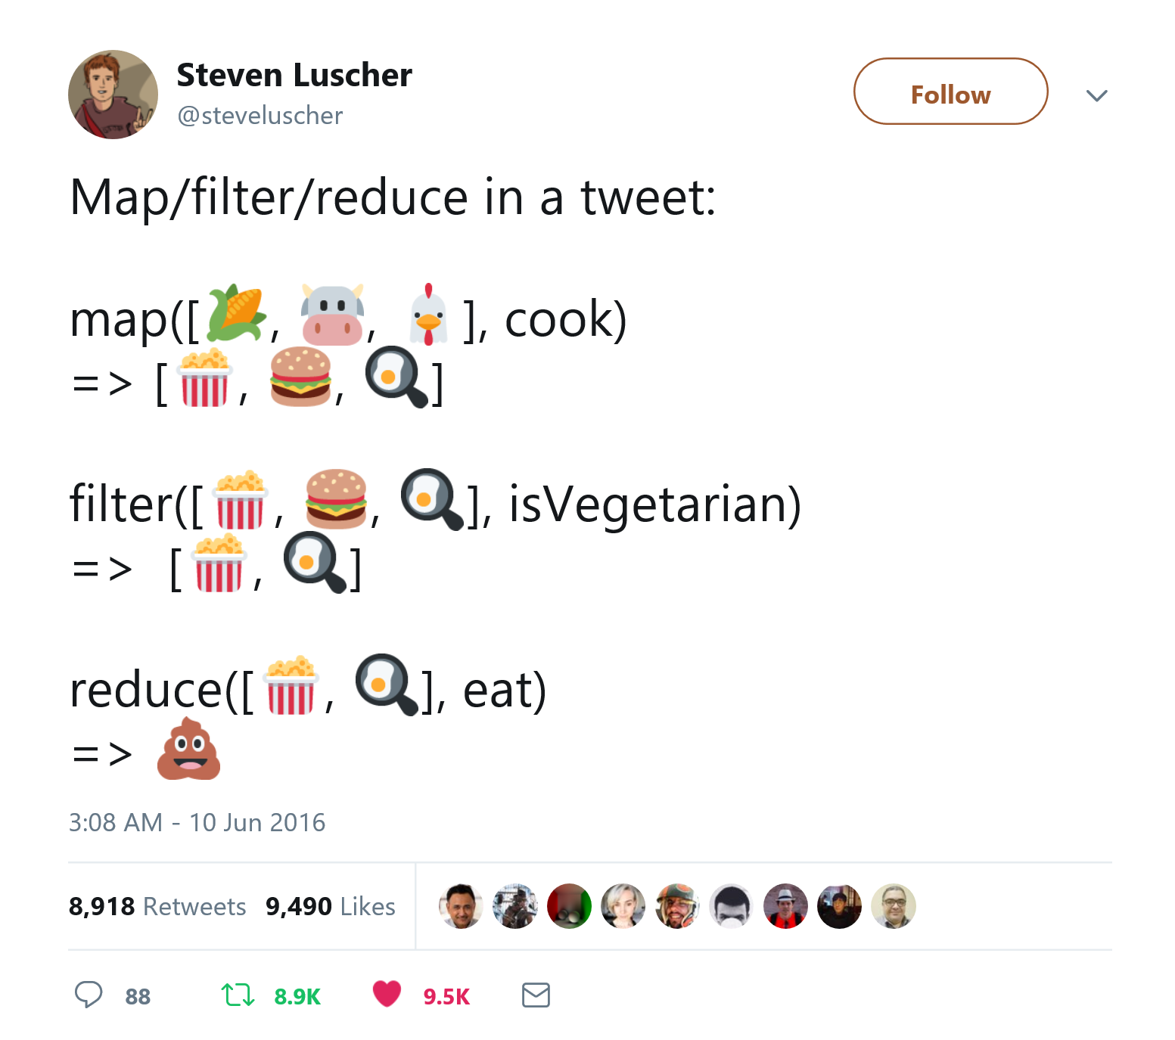
Safety by using Expressions
instead of statements
“what not how“
no side-effects (mutations)
there has to be an initial value
else-branch is required
composable
example { ditch the if }
example { ditch the while/do/for }
[1], [2]

Slide 14
Safety by using Types
instead of living in anarchy
reading the function signature is sufficient
prevents you from yourself
documentation
exhaustive switches
easier refactoring
why not simply use the compiler
example { nlkl/Optional }
example { mcintyre321/ValueOf }
example { mcintyre321/OneOf }
example { Slaying a UI Antipattern }
[1], [2], [3], [4], [5]
Notes:
null vs. nlkl/Optional
mcintyre321/ValueOf (Domain Modelling)
Union Types/Sum Types (mcintyre321/OneOf)
Slaying a UI Antipattern with ELM
but use it in vue with express failing backend, + 3 increments
isLoading + hasError + null
isLoading + errorMessage
‘not-loaded’ | ‘loading’ | ‘success’ | ‘error’
Why Exceptions are not the answer to everything, vs. Errors

Slide 15
Safety by using Types
instead of living in anarchy
“Still, we may not feel these limitations until they have been lifted from us, just as we often do not know we are sick until we suddenly feel better.”
[1], [2], [3], [4], [5]

Slide 16
Safety by generating Code
instead of writing it manually
more setup necessary
documentation must be read
exceptions to the rule are harder (isn’t this an upside)
example { NSwag }
example { VS-Typewriter for SignalR }
[1], [2]

Slide 17
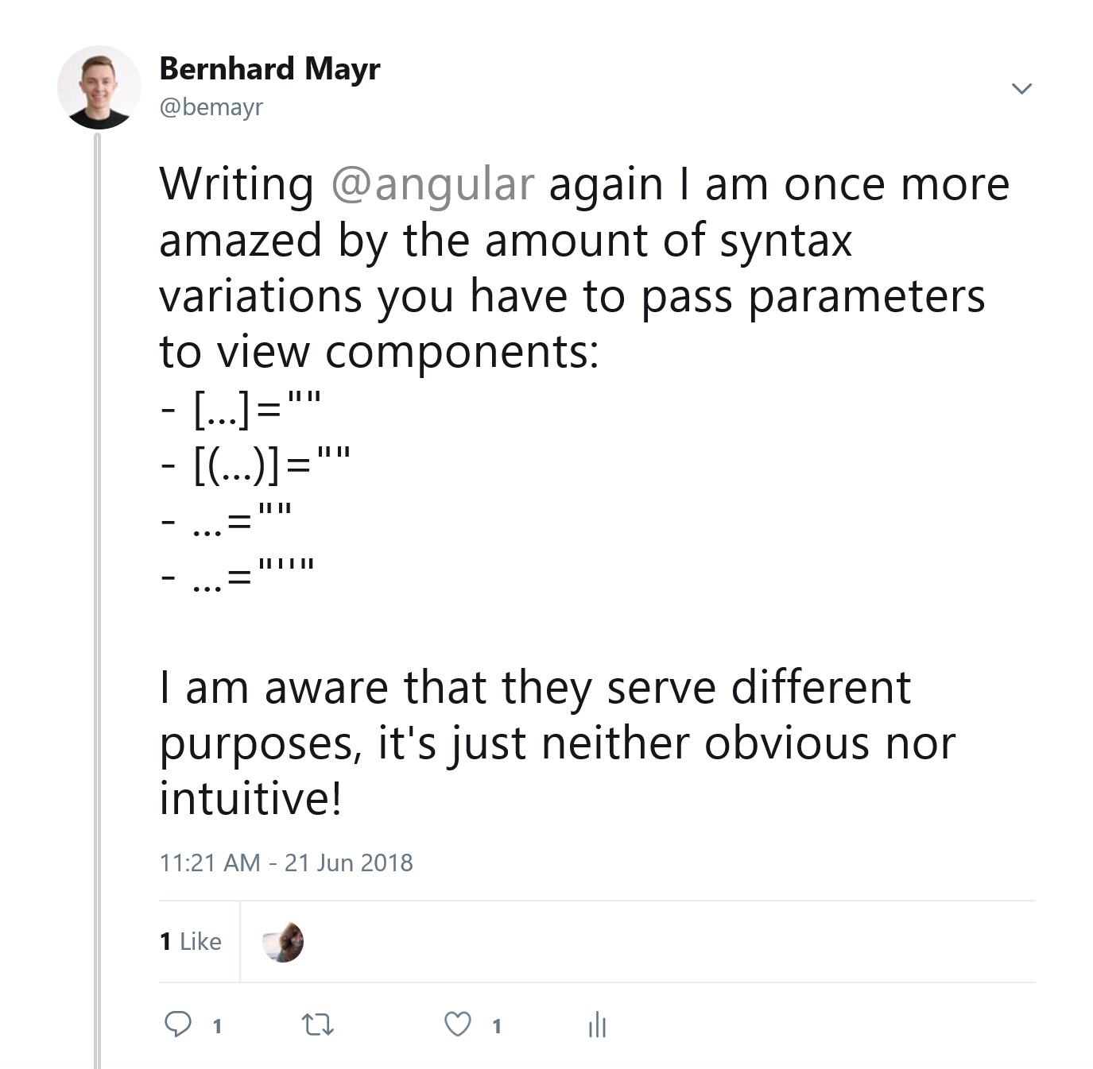
Safety by creating DSLs
instead of template languages
readability
you have to learn fewer languages
dev-tools are free
faster editors, because of fewer plugins
but, it may be something new to learn (isn’t that what our job is about)
example { C# Fluent Time }
example { Verbal Expressions }
example { type-safe HTML & CSS }
[1], [2], [3]
Notes:
C# Time
https://stackoverflow.com/questions/17224090/how-can-i-write-a-fluent-datetime-value#comment24953860_17224151
https://github.com/softawaregmbh/library-holidays/blob/experiments/softaware.Holidays.Core.Tests/Tests.cs
Regex (Verbal Expressions)
http://verbalexpressions.github.io/
Templates vs. In-Language DSLs
HTML
Angular Template Language: https://twitter.com/bemayr/status/1009743078532501504
https://groups.google.com/forum/#!msg/elm-discuss/uXjcVyZ5IYo/g2FlQYc9RjYJ
https://github.com/elm/html
CSS
https://github.com/rtfeldman/elm-css
https://github.com/mdgriffith/elm-ui
https://typestyle.github.io/#/

Slide 18
Safety by using Dev-Tools
instead of using eclipse
consistency
less work (semicolons)
fewer bugs
clean git-diffs
example { tslint/dotnet analyzers }
example { prettier }
[1], [2]
Notes:
linting: tslint/dotnet Analyzers/StyleCop
formatting: prettier, go-fmt, elm-fmt

Slide 19

Future<?>

Slide 20
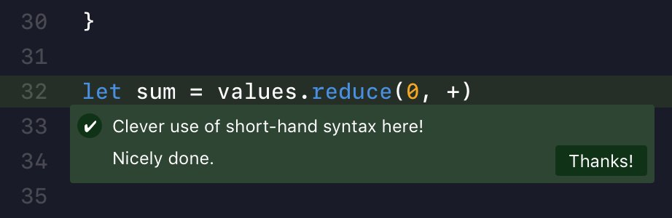
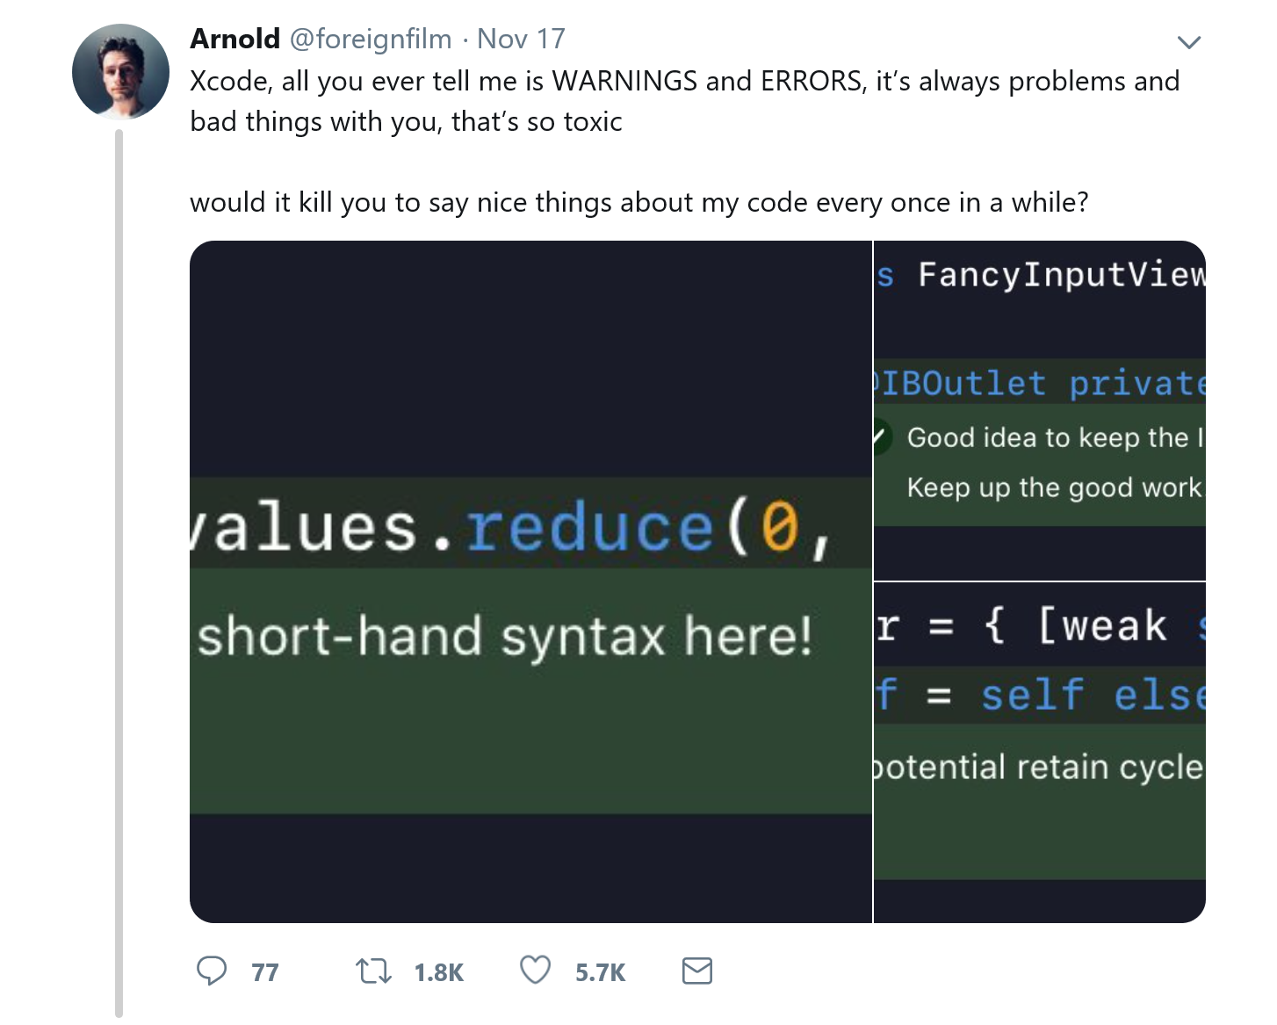
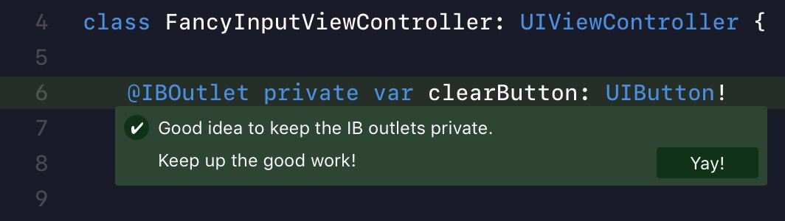
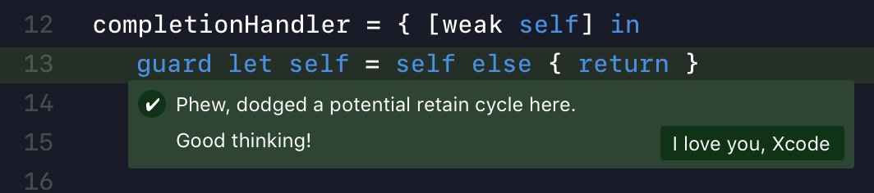

/FOREIGNFILM

Slide 21
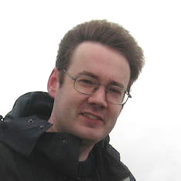
THE COMPILER AS YOUR ASSISTANT THE IDRIS LANGUAGE
Edwin Brady
This doesn't free you from knowing what you are doing, but it does save you from doing the step that really the machine should be able to get by itself.
I like to think of the machine not as a thing that checks my code, but like my lab assistant. [...] We are gonna do some pair-programming, me and the machine.
example { type-driven-development }
Notes:
Initial Pattern Match Clause
Case Split on xs
Type of ?zipWith_rhs_1
Case Split on ys
Type of ?zipWith_rhs_3
Attempt to fill out hole under the cursor
Case Split on ys
Attempt to fill out hole under the cursor

Slide 22
WIE SICH ENTWICKLER SICHER SICHER FÜHLEN

Slide 23
RECAP
RECAP
Being intelligent is not having some magic formula which can one apply to every problem. It is, rather, having a number of ‘formulas’ and not being so much in love with one that it cannot be dropped for another.
– GERALD M. WEINBERG
Notes:
Signposting: Und worum es hier wirklich geht; Jetzt kommt der wesentliche Zusammenhang

Slide 24
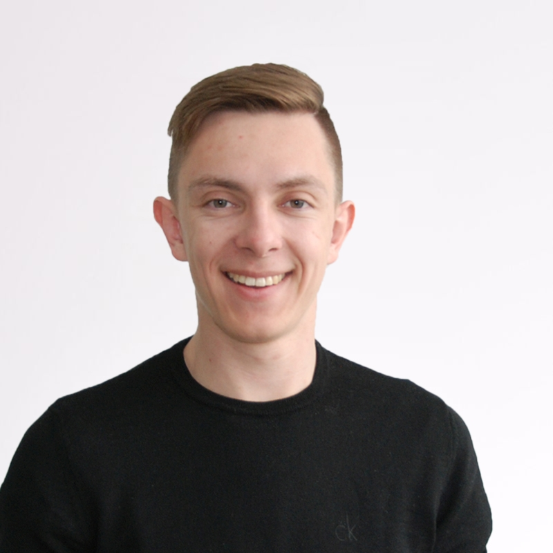




studying psychology and philosophy @ university of innsbruck
studied software engineering @ fh hagenberg
working as a software architect @ innerspace gmbh
Bernhard Mayr
/
bemayr
bemayr/talk.developer-confidence
Notes:
[30 sec]

Slide 25
Tweets
Haskell Hoogle: https://twitter.com/cemerick/status/1068359100931690496
Side Effects in Languages: https://twitter.com/widdnz/status/1067184190150430725
Sum-Types loading = false: https://twitter.com/DavidKPiano/status/1063501519339835397
C# vs. F#: https://twitter.com/MikhailShilkov/status/1011705530648334337
pure vs. impure: https://twitter.com/jckarter/status/1009585088953081856
performance vs. readability: https://twitter.com/DavidKPiano/status/1005107850849456128
Justin’s String Type: https://twitter.com/jusrin00/status/875238742621028355
C# Union Types: https://twitter.com/bemayr/status/993845739657850880
Types Documentation: https://twitter.com/iamsapegin/status/989030140280745985
Compiler vs. Brain: https://twitter.com/bemayr/status/988866064988737539
Types and Compiling: https://twitter.com/ezyang/status/986079031484407808
jsdoc types: https://twitter.com/jusrin00/status/971369672393281536
Refactoring Haskell: https://twitter.com/TheWizardTower/status/963193617287233537
FP Love: https://twitter.com/jdegoes/status/932999912488235010
Hardware vs. Software: https://twitter.com/CodeWisdom/status/908752665408081920
Types vs. Unit Tests: https://twitter.com/peterpme/status/892593371188998144
Staltz Bug Report vs. Compile Error: https://twitter.com/ARealMaxPixel/status/864891754373234688

Slide 26
Sebastian Notes
was kann ich selbst daraus mitnehmen
Sicherheitsgefühl
Psychologie -> könnt ihr euch an Falle A, B erinnern; habt ihr das schon mal erlebt
Zitate: immer im Zusammenhang
Frage: Was macht ihr dafür? Wir sind eine Community, wir sind alle Menschen mit gewissen Besonderheitene unserer Psyche und können uns gemeinsam weiterentwickeln. Als Mensch weiterentwickeln und mit dem Aspekt der Qualität daran wachsen.

